Slide 1
Area’s of development that influence stages in the lifespan.
stage | Age Group
infancy | Birth to two years
childhood | 2 to 10 years
adolescence | 10 to 20 years
early adulthood | 20 to 40 years
middle age | 40 to 65 years
older age | 65 years and beyond
Notes:
These are the AREAS of Lifespan development (Emotional, Social, Physical, & Cognitive) and how they influence the stages of development.

Slide 2
EMOTIONAL DEVELOPMENT

Slide 3
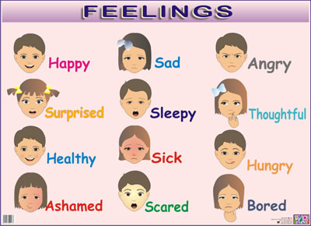
What is it?
Studying Emotional Development involves analysing emotions and feelings.

Slide 4
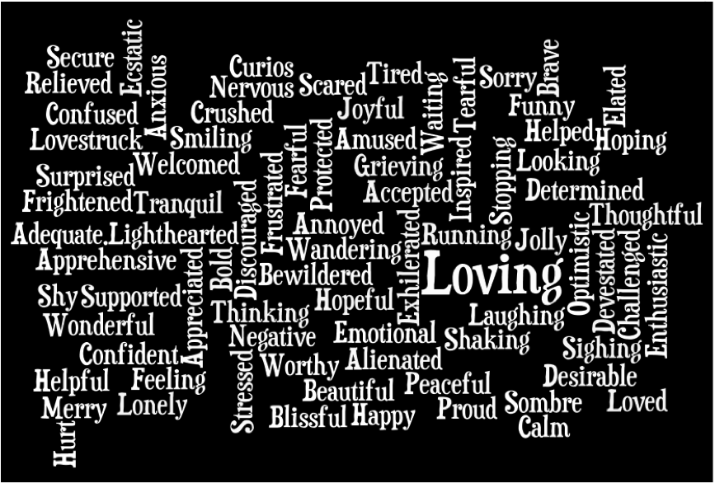
What is it?
Studying Emotional Development involves analysing emotions and feelings. How is everybody feeling today?

Slide 5
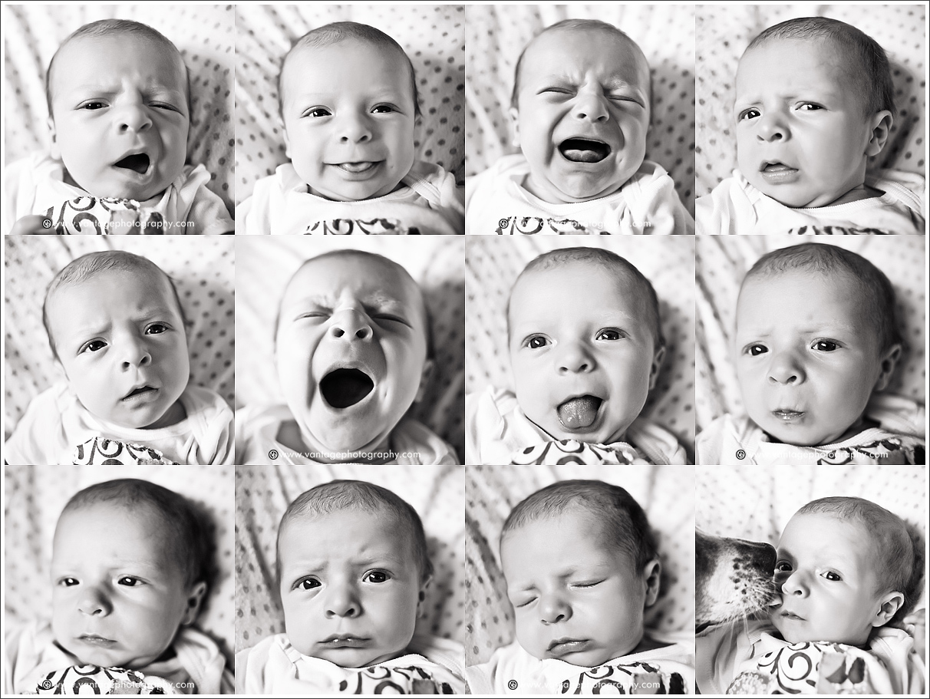
If we are to study emotions, we start from when we were little...

Slide 6
.... And the first think we look at is
ATTACHMENT

Slide 7
ATTACHMENT
Think-Pair-Share: Brainstorm the term “ATTACHMENT” What is it?? 2 minutes

Slide 8
Attachment – definitions (p.184)
Psychological bond
First described by psychologist John Bowlby, nowadays described as ‘the tendency of infants to form an emotional bond to another person, usually their main caregiver’

Slide 9
Why study ATTACHMENT??
Psychologists believe that the attachments formed during infancy – particularly in the first 12 months of life – has a considerable influence on a person’s emotional development throughout the life.

Slide 10
Key words:
Attachment figure / Attachment target = the person to whom the infant is attached to most

Slide 11
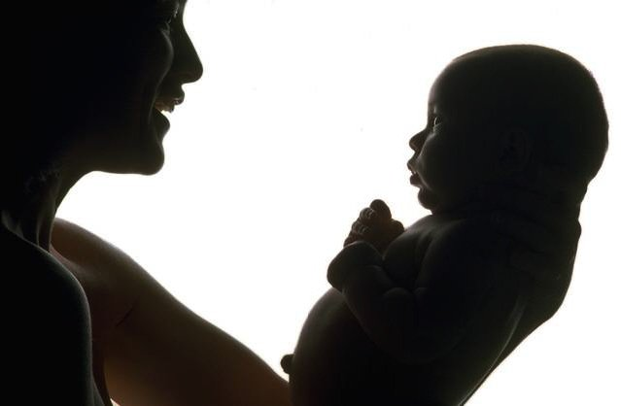
Bowlby thought that 4 things need to be present for a strong, solid and safe attachment to form:

Slide 12
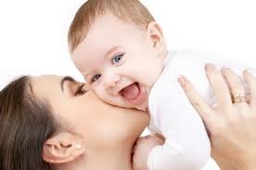
Proximity maintenance

Slide 13
Proximity maintenance = the infant wants to be near the person to whom it is attached

Slide 14
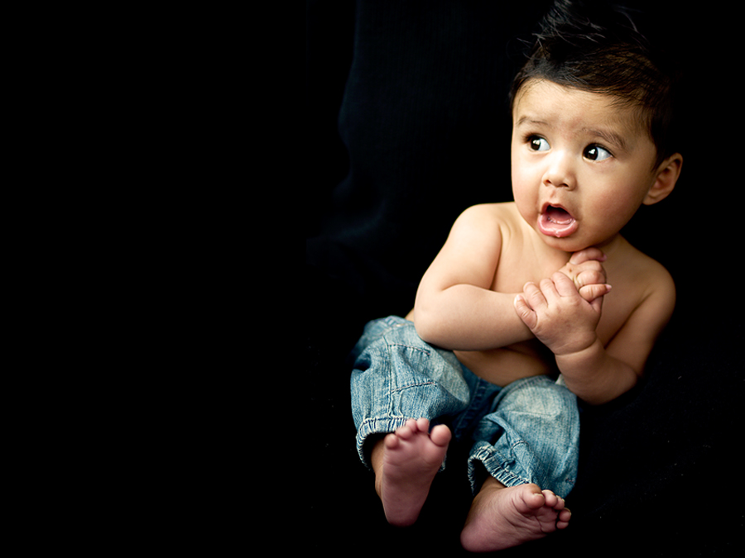
Safe haven

Slide 15
Safe haven = the infant needs to be able to come back to the attachment figure for comfort and safety when feeling scared, unsafe or threatened

Slide 16
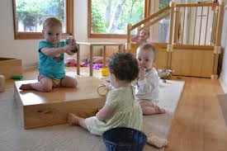
Secure base

Slide 17
Secure base = the infant feels safe around his/her attachment figure and is therefore confident exploring surrounding environments

Slide 18
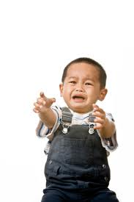
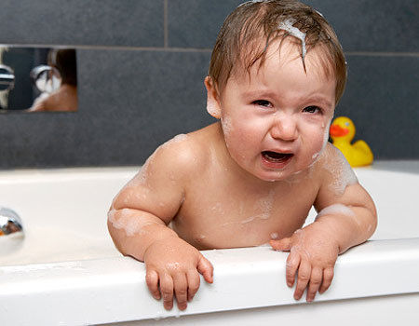
Separation distress

Slide 19
Separation distress = the infant feels anxious when the attachment figure leaves.

Slide 21
Bowlby thought that the attachment/bond is important for two reasons:
For healthy emotional development later in life
Evolutionary function – improves chances of survival

Slide 22
Is it true that infants’ main/primary attachment figure is their mother?
Individually think (if you can remember) when you were an infant, who were you more attached to? Mother? Father? Grandparents? Other carers??? Why?
If you can’t remember, think of someone else’s infants. Who are they mostly attached to and why?

Slide 23
Bowlby’s controversial idea was that:
Mothers are the best attachment figures. Now you know that it’s not true.

Slide 24
Possible Indicators of Attachment
Some occur more frequently, others may not occur at all
L.A 5.7 / p.188
2 groups perform, each group performs 2 behaviours that indicate attachment

Slide 25
Recap Quiz from last lesson:
Emotional development:
Begins at birth and ends at age 12
Is a life long process
Formed during infancy has a considerable influence on a person’s emotional development throughout the life.
Has its peak in middle age
b) and c)

Slide 26
2. Attachment is ....................... Formed between the infant and their caregiver
Psychological bond
Cognitive bond
Social bond
Toddler bond

Slide 27
3. Who was the psychologist who came up with the term Attachment?
John Boily
John Border
John Bowlby
John Boler

Slide 28
4. The Attachment Figure is a person to whom the infant is attached to and:
Who spends a quality time with the infant
Who spends holiday time with the infant
Who doesn’t spend any time with the infant
To whom the infant feels most attached to

Slide 29
5. The 4 things that need to be present for a strong attachment to form are:
Proximity maintenance, safe haven, secure base, separation distress
Proximity maintenance, safe heaven, secure base, separation distress
Proximity formation, safe haven, solid base, separation distress
Proximity formation, safe haven, solid base, reunion distress

Slide 30
6. According to Bowlby, attachment is important for which 2 reasons?
It promotes romance later in life, improves chances of survival
It promotes empathy; it reduces anti-social behaviour
It promotes pro-social behaviour; it reduces anti-social behaviour
Improves chances of survival; for healthy emotional development throughout the life

Slide 31
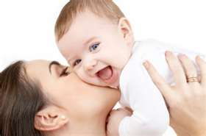
Types of Attachment (Mary Ainsworth)
2 main categories:
Secure
Insecure – resistant
- avoidant

Slide 32
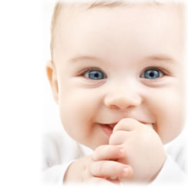
Secure attachment
Secure attachment
Infants show distress when the mother leaves and are delighted to see her when she returns
Their distress quickly disappears and they happily cuddle with her
About 65% of one-year-olds are securely attached.

Slide 33
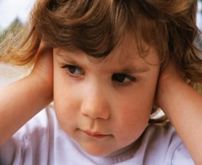
Insecure attachment
Insecure-avoidant attachment
Children show very little or no reaction when the mother leaves them, or when she comes back
May be the result of neglectful or abusive caregivers.
About 20% of one-year-olds are in this category

Slide 34
Insecure attachment
Insecure-ambivalent/anxious/resistant attachment (confused, getting mixed messages)
Children become very distressed when the mother leaves. When she returns they may cling to her but show ambivalent (mixed) reactions, such as hitting her while still clinging
May be the result of caregivers who aren’t responsive to infants’ needs
About 12% of one-year-olds are in this category

Slide 35
SECURE: “Even when Mum’s not here, I
can count on her. After all, she’s always
been there when I needed help.”
AVOIDANT: “She’s never around, but I
don’t care. I didn’t want her anyway...”
ANXIOUS: “Sometimes Mum is there and
sometimes not. What if something goes
wrong today? What will I do? I hate
feeling this way! Where is she??”

Slide 36
Did you know...????
Adult romantic behaviour
Hazan and Shaver – ‘love quiz’
Secure = Positive love relationships, trusts others and believes in enduring love
Avoidant = fearful of closeness, believes love won’t last and is not necessary to be happy
Resistant = preoccupied with love – fall in love easily but have trouble finding true love

Slide 37
The Strange Situation Test
Designed by Mary Ainsworth to test the types of attachment = series of separation and reunions between the mother and the child to observe the child’s reactions.
http://www.youtube.com/watch?v=s608077NtNI
Participants in experiment 1: mother, Lisa (infant), stranger, experimenters
Participants in experiment 2: mother, Eva (infant), stranger, experimenters

Slide 38
Your tasks

Slide 39
There are two experiments in this video. Answer the following questions. For experiment one:
How does Lisa behave when her mother leaves the room?
Does Lisa calm down when the stranger tries to comfort her?
How does Lisa behave when her mother returns?
What type of attachment does she display?
What is the link between Lisa’s type of attachment and her mother’s parenting style?

Slide 40
For experiment two:
How does Eva behave when her mother leaves the room?
How else is Eva different from Lisa?
What type of attachment does Eva display?
What is the link between Lisa’s type of attachment and her mother’s parenting style? (Listen to what the psychologist in black suit and glasses have to say)

Slide 41
Individual Task
On your laptops go to YouTube and find a video of a child who demonstrates
Ambivalent / Resistant attachment in relation to their caregiver

Slide 42
The phases of the Strange Situation Test - Recap
8 episodes, each one lasting about 3 minutes
Mother and baby enter room.
Mother sits and responds to infant if it wants attention
Stranger enters, talks to mother and gradually approaches baby. Mother leaves.
Stranger and baby together
Mother returns stranger leaves. When baby is settled, mother leaves again
Baby is alone
Stranger returns and is alone with baby
Mother returns and stranger leaves.

Slide 44
The stages of the Strange Situation Test – you also find this on p.190, Table 5.1
What do these key words mean to you in relation to Ainsworth’s Strange Situation Test?
Stranger anxiety
Separation anxiety
Reunion

Slide 45
Play – The Strange Situation Test
3 people in each scenario.
Secure attachment
Insecure avoidant attachment
Insecure ambivalent/resistant attachment
Before you perform, tell us who is the mother, who is the child and who is the stranger.

Slide 46
Textbook p. 191, L.A. 5.8
Choose to do this activity as a class discussion OR write the answers in your notebook.
2 groups – group 1 discusses the five points with the teacher
- group 2 writes the answers in the notebook

Slide 47
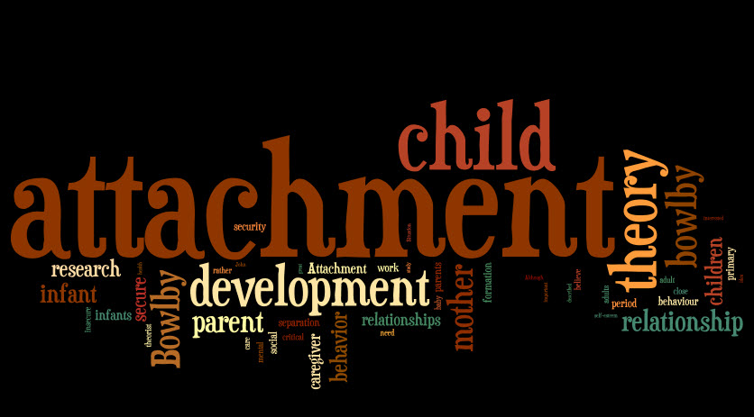
How human attachments form (Bowlby’s view)

Slide 48
Multiply & Merge activity – p. 191-192
Individually read the text on pp. 191 – 192 and choose 4 ideas/facts that you find most interesting / worth knowing.
Pair up with someone else and negotiate your and their ideas down to a list of 4
(8 ideas become 4)
Each pair joins another pair to become a group of four and they negotiate their list (8 ideas) down to final 4 ideas/facts.

Slide 49
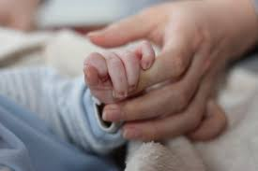
What 4 ideas/facts did you find most interesting?
Each group shares their 4 ideas to the class

Slide 50
The 4 facts I (Lucie) found most interesting...
Attachment is a two-way relationship
Sensitive/Critical period
The impact of children who spent their childhood in orphanages with minimal physical contact with a carer -> emotionally withdrawn and overwhelmed by interactions with other children later on
Most contemporary psychologists do not agree with Bowlby that there is a sensitive
period for human infant-caregiver attachment

Slide 51
Welcome Back ☺

Slide 52
HW 1: Factors influencing attachment p. 193
Task 1: List at least 2 characteristics of the caregiver that have an impact on forming an attachment
Task 2: List at least 2 characteristics of the infant that have an impact on forming an attachment

Slide 53
HW 2: Revision Worksheet
Individually complete this Worksheet that I just gave you – Activity 6.3
Notes:
Use whiteboard and make notes

Slide 55
Child of Rage
Watch this video
http://www.youtube.com/watch?v=ME2wmFunCjU
Discuss in your groups:
What did you find most disturbing?
Why did Beth want to hurt her brother and her adoptive parents?
What type of attachment may have she developed?
What was the research method in this study?
What were the characteristics of Beth’s biological father?
What were the characteristics of Beth?
What may be the long-term consequences for Beth when she grows older and why?

Slide 56
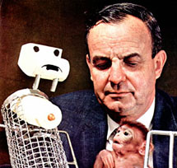
Last topic in this chapter on Emotional Development
Harlow’s experiments on attachment in monkeys

Slide 57
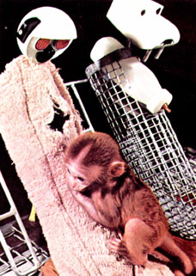
Harlow’s experiments on attachment in monkeys
Words that you may not know:
Surrogate = anything which substitutes for or
plays the part of something
else.

Slide 58
Key Words – Predict what the topic is about
Largest Words: Middle-size Words:
Monkeys Attachment
Mother Monkey
Cloth Normally
Mothers Surrogate
Wire Experiments
Infant Period
Deprivation Critical
Object Response
Harlow Found
Stress
Bare
Must

Slide 59
Videos on this topic:
http://www.youtube.com/watch?v=_O60TYAIgC4
http://www.youtube.com/watch?v=hsA5Sec6dAI
Textbook – p. 195, 196 - What is this topic about?
1. Individually highlight in your text
Main ideas in the passage
Information that You find interesting
2. Compare and discuss in:
Pair – Square – Write down

Slide 60
- 2 surrogate mothers - Infant monkey separated from its birth mother
1. Condition:
Cloth surrogate mother with feeding bottle
Wire surrogate mother with feeding bottle
Conclusion: the infant monkey spent around 15 hrs a day in contact with the cloth surrogate mother.

Slide 61
2. Condition:
Cloth surrogate mother without feeding bottle
Wire surrogate mother with feeding bottle
Conclusion: The infant monkey still preferred the cloth surrogate mother and used the wire surrogate mother only to be fed.

Slide 62
3. Condition:
Cloth surrogate mother without feeding bottle
Wire surrogate mother with feeding bottle
The monkey is being purposefully frightened by the experimenter
Conclusion: The infant monkey sought and found comfort in the cloth surrogate mother

Slide 63
4. Condition:
The infant monkey has been completely isolated, without any kind of mother (surrogate or biological)
The monkey is being purposefully frightened by the experimenter
Both cloth and wire surrogate mothers are present after monkey has been frightened
Conclusion: the infant monkey is in his own world, withdrawn, doesn’t seek comfort in any surrogate mother – a little bit like Beth, The child of rage

Slide 64
Share with the class 1. What was the nature of Harlow’s experiments with monkeys in relation to attachment? 2. Can Harlow’s conclusions be generalised to human infant attachment?

Slide 65
What was the nature of attachment in this experiment?
Nourishment vs. Comfort/Security
Physical bond vs. Psychological bond

Slide 66
Other animal experiments by Harlow
Individually read the text on pp. 197-198 and choose 4 ideas/facts that you find most interesting / worth knowing.
Pair up with someone else and negotiate your and their ideas down to a list of 4
(8 ideas become 4)
Each pair joins another pair to become a group of four and they negotiate their list (8 ideas) down to final 4 ideas/facts.

Slide 67
In your groups, answer the following questions:
What were the Independent and Dependent Variables in these experiments?

Slide 68
In your groups, answer the following questions:
What were the Independent and Dependent Variables in these experiments?
IV = The time that the monkeys spent isolated in cages (3months / 6months / 12 months)
DV = The type of behaviour (slightly distressed, moderately distressed, very distressed) that the monkeys displayed after being released into the company of normally reared monkeys

Slide 69
Oral presentation
P. 199 – L.A 5.13
In pairs prepare an interview between a journalist and Harry Harlow on the topic of attachment.

